Slide 1
Rainfall analysis
Presented By:
Name: Aswin. R
college: St. Peter’s College of Engnieering & Technology
Department: Civil Engnieering

Slide 2
Problem Statement
Design a comprehensive rainfall data analysis and predictive Therefore, there is a critical need for advanced rainfall data analysis accurately assess rainfall patterns, predict future trends, and develop resilient infrastructure solutions that mitigate flood risks and ensure sustainable urban development."

Slide 3
System Approach
System Requirements:
Hardware:
CPU: intel core i5 9th gen
RAM: 4GB
Data Sources: Meteorological stations, satellite imagery, hydrological models
Data Storage: cloud storage solutions, 1GB storage max
Software Environment: Python or R, as well as specific software packages for statistical analysis

Slide 4
Library Approach
Library Requirements:
Pandas: Pandas is a powerful Python library for data manipulation and analysis.
NumPy: NumPy is a fundamental package for scientific computing with Python.
Matplotlib: Matplotlib is a popular Python library for creating static, interactive, and animated visualizations.

Slide 5
Algorithm & Deployment
Algorithm in Rainfall Data Analysis:
Data Cleaning and Preprocessing: Algorithms are used to clean and preprocess rainfall data by handling missing values, removing outliers, and standardizing formats.
Exploratory Data Analysis (EDA): Visualization algorithms, statistical methods, and machine learning techniques are often employed for EDA.

Slide 6
Algorithm & Deployment
Machine Learning Models: Machine learning algorithms are used for predictive modeling and forecasting of rainfall patterns. Regression algorithms, such as linear regression, and time series forecasting algorithms
Statistical Analysis: Various statistical algorithms are applied to rainfall data to quantify variability, calculate summary statistics, and test hypotheses.

Slide 7
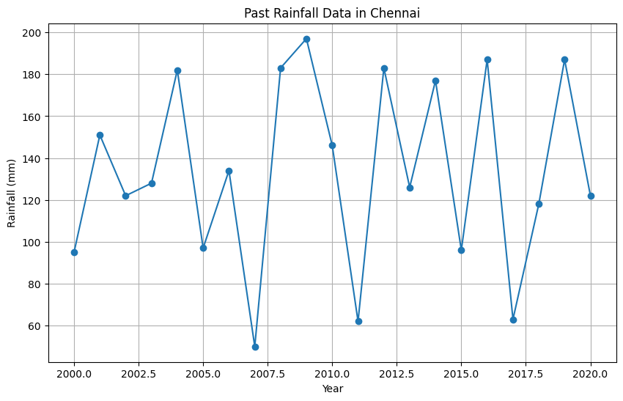
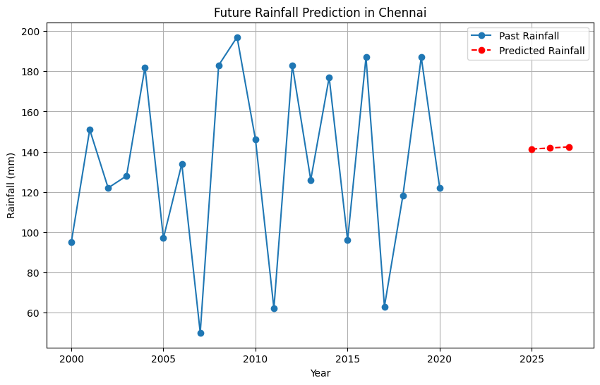
Result

Slide 8
Conclusion:
Understanding rainfall patterns is essential for building climate-resilient cities and ensuring the long-term sustainability of urban ecosystems. By leveraging data-driven insights and innovative approaches, Through collaborative efforts and informed decision-making, we can pave the way towards a sustainable future for generations to come.

Slide 9
Thanks you

